Slide 1
SDSoC Development Environment
Zynq
SDSoC 2015.4 Version

Slide 2
Objectives
After completing this module, you will be able to:
  Describe the SDSoC development environment
  List some examples of SDSoC use cases
  List some of the benefits of using SDSoC
  Identify some of the underlying tools the SDSoC development environment uses
  Describe the SDSoC development flow
  List steps involved in creating an SDSoC project

Slide 3
Outline
SDSoC Development Environment
Use Cases
SDSoC Development Flow
SDSoC Project Creation
Summary
Lab1 Intro
Appendix

Slide 4



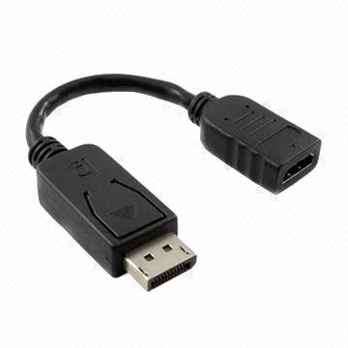
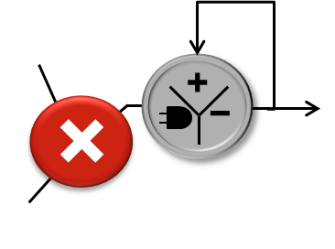
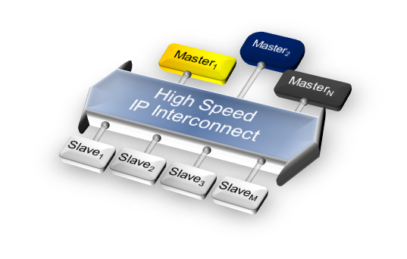
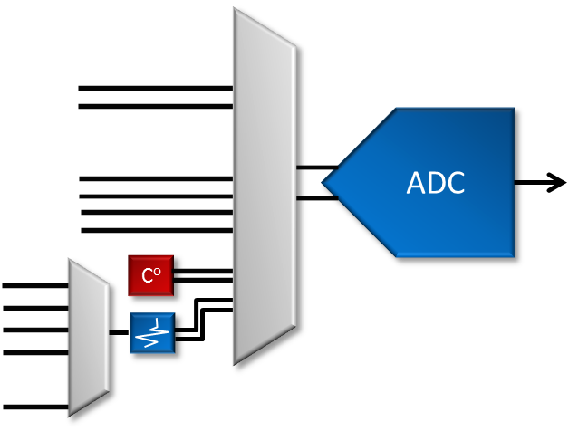


Zynq-7000 All Programmable SoC Highlights
Application Processors
Up to 1GHz
Single & Double Floating Point
7-Series
Programmable Logic
28K-440K Logic Cells
Hard PCIe Gen2x8
A9
Flash Controller
Memory Controller
DDR3, DDR2, LPDDR2
AMBA
AMBA
Integrated Memory
Mapped Peripherals
e.g. USB2.0, GigE, SDIO, CAN
High Bandwidth Memory & DSP
Internal L1/L2 Cache and OCM
DDR3, DDR2, LPDDR2 w/ ECC
Up to 2,662 GMACs of DSP perf.
SPI
I2C
ARM Dual-Core
Cortex™-A9
CAN
UART
AMBA
GPIO
512 KB L2 Cache
SDIO
256 KB On-Chip Memory
USB
GIC
SCU
GigE
AMBA
Security
AES,
SHA, RSA
AMBA
Integrated Analog
Dual multi-channel 12-bit ADC
Up to 1Msps
Temp & Voltage sensors
General Purpose
AXI Ports
High Performance
AXI Ports
AXI Interconnect
Up to 100Gb of bandwidth
Over 3000 interconnects
ACP Acceleration Port
Programmable
Logic
ACP
XADC
Block RAM
DSP
PCIe
GTX
Transcievers
Runtime SW & Tools
Eclipse-based SDK for profiling and performance analysis
Cross-trigger/Heterogeneous Debug, Run-time Libraries
Extensive support for OS, RTOS, AMP, Hypervisor
PetaLinux for easiest out-of-box development

Slide 5
SDSoC Development Environment
What is it?
  SDSoC provides a familiar embedded C/C++ application development experience including
    An easy to use Eclipse IDE
    A comprehensive design environment for heterogeneous Zynq SoC and MPSoC
    C/C++ full-system optimizing compiler
  SDSoC enables function acceleration in PL with a click of button using various technologies
    Vivado IPI
    Vivado HLS
    SDK
    Profiler
  SDSoC provides infrastructure to combine processing system, accelerators, data movers, signaling, and drivers

Slide 6
Benefits of SDSoC Development Environment
Shorter development cycles
  Estimation shows improvement over software-only solution for system and accelerators
  Iterative improvement can be made at early stages of development without the need to build hardware
Simplified interface and partitioning between hardware and software
  Software-based flow vs RTL
  User interfaces with software-only tools; hardware management is abstracted
  Removes much of the hardware/software distinction and throw-over-the-wall effect
Automated initial design
  Users can tweak code at macro- and micro-architectural levels
  Designers still have manual control over the constructed Vivado HLS tool and Vivado Design Suite projects

Slide 7
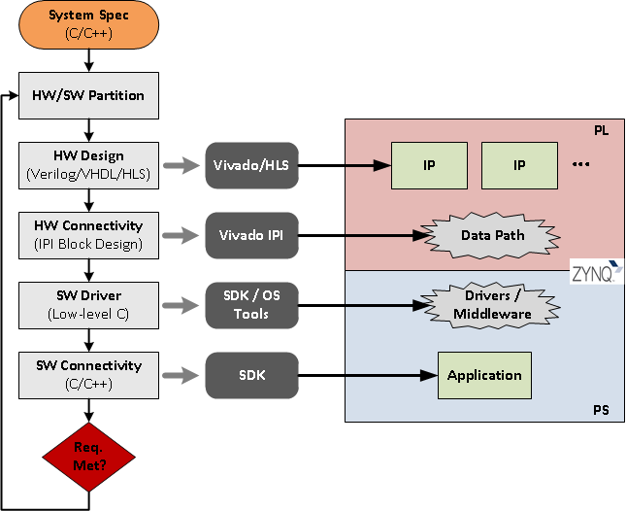
Development Flow Without SDSoC
Overall process requires expertise
at all steps in the development process
  Various hardware design entries
  Hardware connectivity at system level
  Driver development to drive custom
  hardware
  Integrating with application and target OS

Slide 8

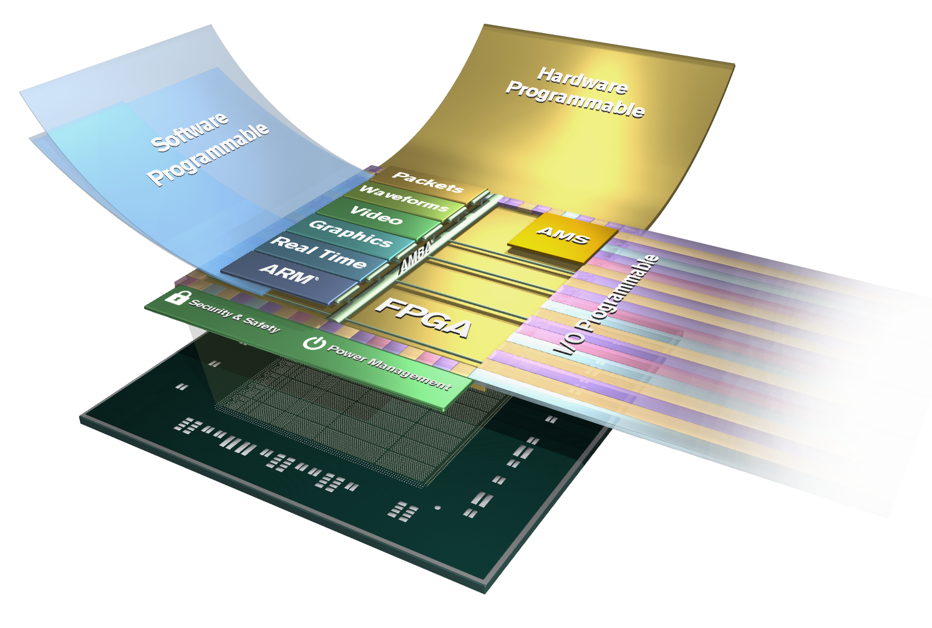

SDSoC - Unified Development Environment
ASSP-like programming experience
System-level profiling
Full system optimizing compiler
Expert use model for platform developers and system architects
C/C++ Development
Rapid System Level Performance Estimation
System-level Profiling
Specify C/C++Functions for Acceleration
Full system
Optimizing Compiler
Notes:
Slide objective: Introduce the key pillars of SDSoC
Key Point: SDSoC provides a comprehensive ASSP-like design environment
Script:
The SDSoC Development Environment provides a greatly simplified ASSP-like C/C++ programming experience including an easy to use Eclipse™-based integrated development environment (IDE) and a comprehensive design environment for heterogeneous Zynq platform deployment. Complete with the industry’s first C/C++ full-system optimizing compiler, SDSoC delivers system level profiling, automated SW acceleration in programmable logic, automated system connectivity generation, and libraries to speed programming. It also provides a flow for customer and 3rd party platform developers to enable platforms to be used in the SDSoC development environment.

Slide 9
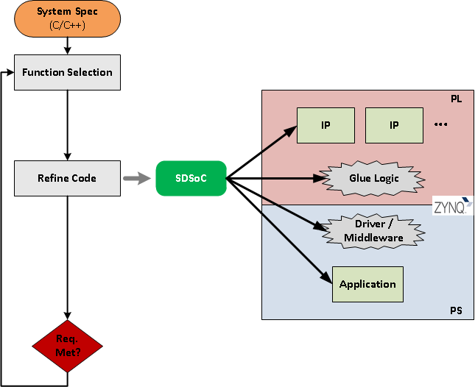
SDSoC Development Environment
SDSoC development environment consolidates a multi-step/multi-tool process into a single tool and reduces hardware/software partitioning to simple function selection
  Code typically needs to be refined to achieve optimal results

Slide 10
Outline
SDSoC Development Environment
Use Cases
SDSoC Development Flow
SDSoC Project Creation
Summary
Lab1 Intro
Appendix

Slide 11
Example: Back Projection
HW Solution using 52 floating point operations at 166MHz
DMAs connected to ACP port for short communication times
Two-accelerator system an early SDSoC proof of concept
Used in tomography applications, including CAT scanners
Seconds/Frame
Processes
7x Speedup

Slide 12



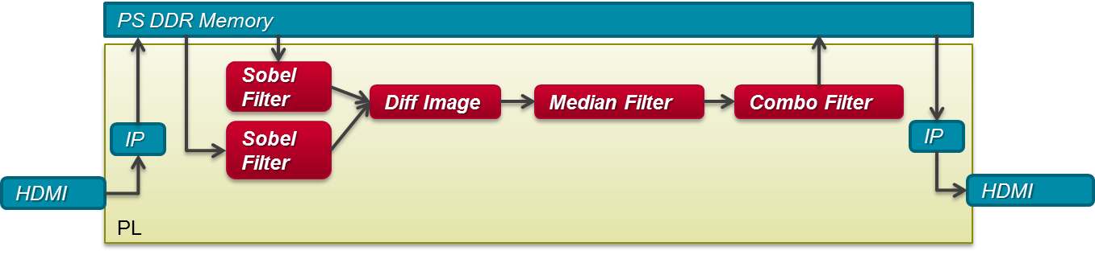


Example: Motion Detection @ 1080p60
main(){
get_camera(A);
sobel(A,B);
diff(B,C);
…
display(out);
}
ZC702 + HDMI FMC Platform
Entire design completed in 2-weeks with multiple iterations of algorithm
ZC702 + HDMI FMC card

Slide 13
Outline
SDSoC Development Environment
Use Cases
SDSoC Development Flow
SDSoC Project Creation
Summary
Lab1 Intro
Appendix

Slide 14


SDSoC Development Flow
madd(inA,inB,out){
}
main(){
init(A,B,C);
mmult(A,B,D);
madd(C,D,E);
consume(E);
}
mmult(inA,inB,out){
}
HLS
cross-
compiled
C-callable IP
Optimized RTL IP
Synthesizable
C/C++
Fast performance estimation
App
SW
PS
PL
System optimizing compiler
A,B
mmult
SW glue code
D
C
madd
E
OS, BSP
Target Board
Compiler infers data communication, uses data mover IP
Boot image incl. ELF+.BIT
System linker generates hardware system, software stubs, APIs and configuration
Platform (can incl. PL)

Slide 15
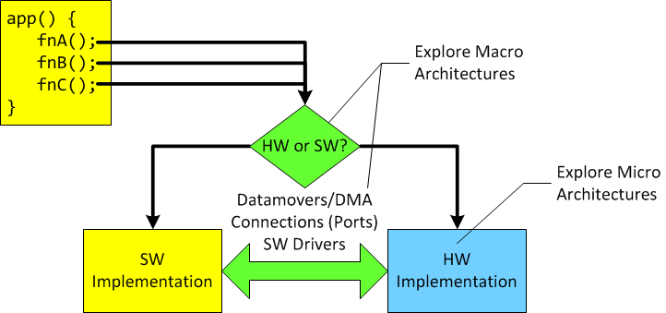
System-level Considerations
What gets accelerated?
How is software implemented in hardware?
  Is hardware design expertise available?
How will software and hardware talk to each other?
Will it meet performance requirements the first try?
  What changes are required at the macro/micro-architecture levels (or both)?

Slide 16
Candidate for an Accelerator
Not every function can be a candidate for acceleration
  For example, pre-compiled code, some user libraries, OS services, etc.
Computationally intensive algorithms are ideal candidates
  Profiling results help identify performance bottlenecks
    Just because a function takes a long time, it is not automatically a candidate
  Slight code modifications (or pragmas) effect the microarchitecture of the accelerator
Trade-off between data movement costs and acceleration benefits should be considered
Amdahl's law can be used to determine potential speedups

Slide 17
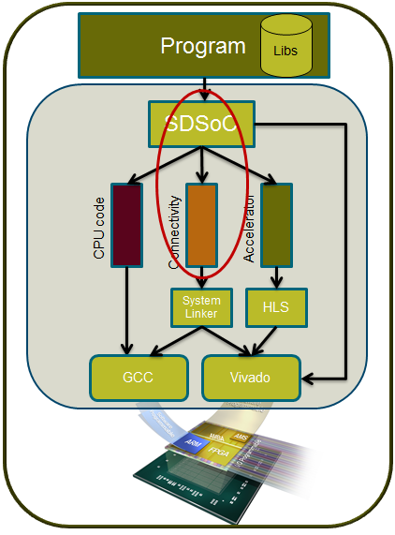
Simplifying Hardware/Software Partitioning
SDSoC development environment simplifies the process of identifying and accelerating functions
  Integrates profiling tools
  Provides libraries for accurate timing measurements
  User selects functions to accelerate
  Estimates hardware speed-up
Automated acceleration is achieved through
  Advanced analysis of code using specialized compilers
  Assistance of user-specified pragmas
  Extension of a predefined hardware platform
Hardware platforms packaged with the environment and from third parties
  Environment extends platform, providing additional capabilities

Slide 18
User Development Flow
C/C++ Application running on ARM
User-assisted SW-HW partitioning based on profiling
Select functions to move to HW
Optimize data transfer and parallelism using SDSoC guidelines
Configure
Specify platform
Specify OS
Specify functions to move to HW
Specify monitor points
Optimize accelerator code
Build to generate SW and HW
Analyze performance
Run fast estimation
SD Card Image
Boot image
Linux/Standalone
Application Elf file
Run on the board

Slide 19
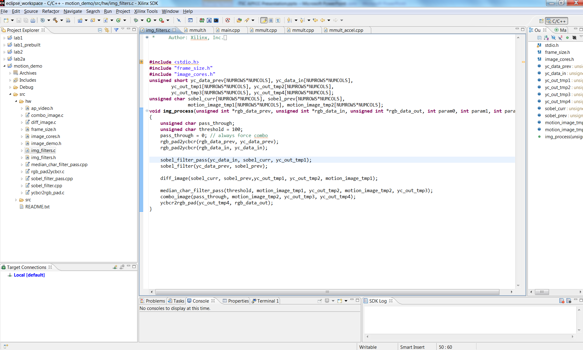
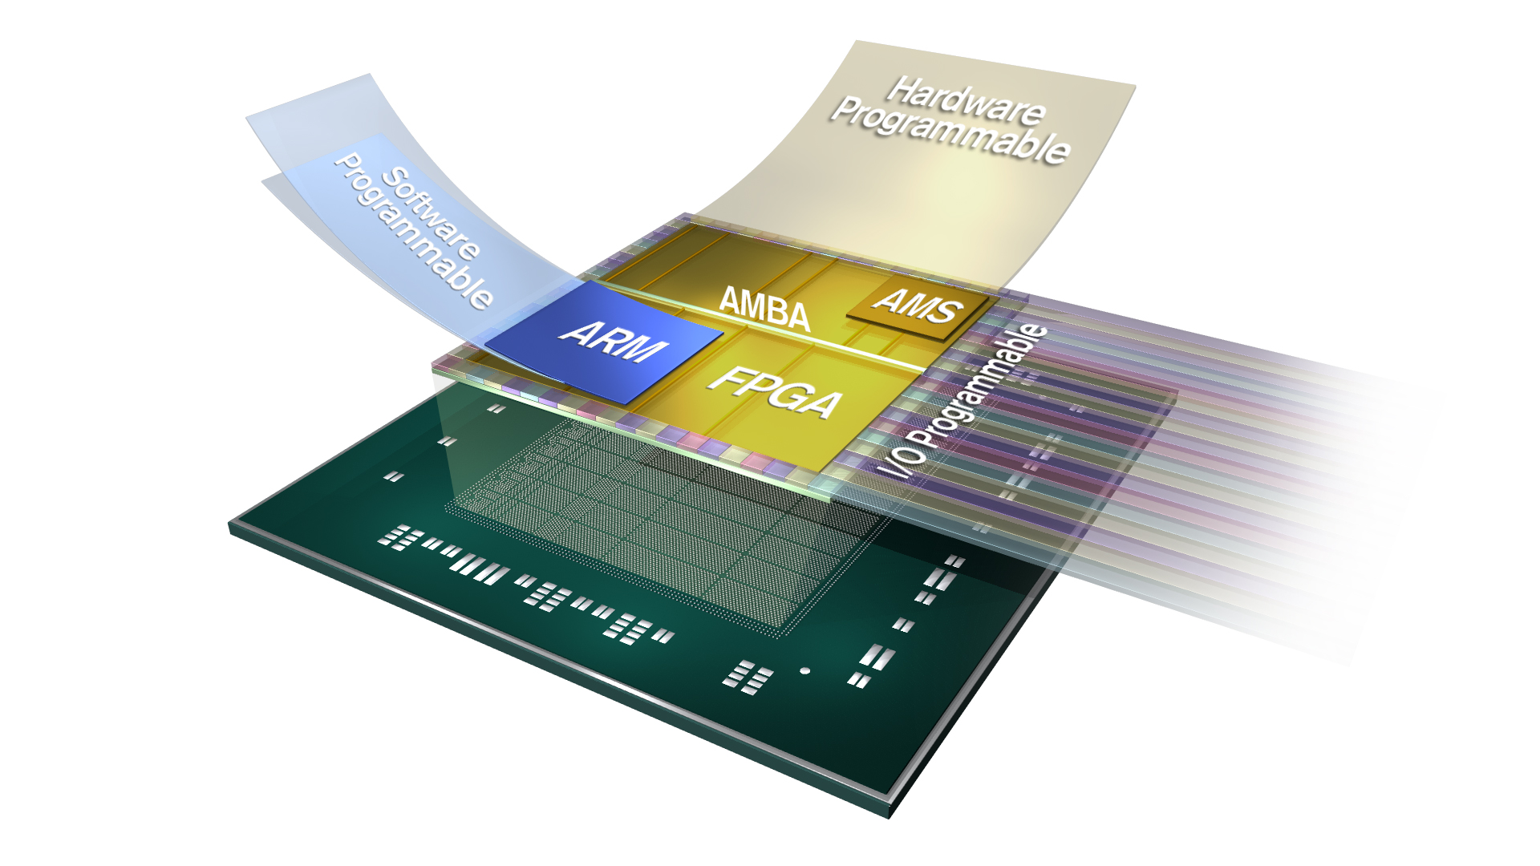
SDSoC: Complete End-to-End Flow
C/C++
Estimator
Compiler
Debugger
Profiler
Simple familiar SW development environment
Vivado
HLS
IP Integrator
HSM
ARM Compiler
Proven design tools and technologies
SW Code
PS
PL
A complete C to system flow!
IP
IP
Connectivity
Generated driver
IP
IP
OS, BSP
Target Board
Platform

Slide 20
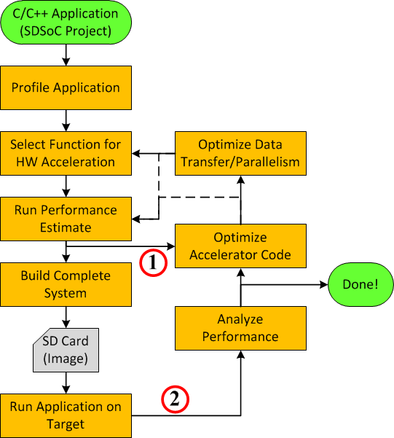
Development Flow
Without hardware generation, the SDSoC development environment acts like a normal C/C++ IDE
It starts with a pure software system and ends with an accelerated SW/HW system
  Developers select C functions for hardware acceleration
SDEstimate provides quick-turns to get architectures close
  Used in early development
SDRelease generates full hardware/software products
  For later and final stages of development

Slide 21
Profiling the Application
The goal of offloading software to hardware is to improve overall system performance
Finding software eligible for acceleration follows general software optimization practices
  Profiling yields the necessary data by summarizing where execution time was spent
The SDSoC development environment includes the TCF profiling tool
  No code instrumentation or special recompiling required
  Profiling results show percentage of time spent in functions relative to a total execution time
For absolute timing measurements sds_lib offers some functions for collecting system timer values
  Timer resource must be available and code must be changed to incorporate timer functions

Slide 22
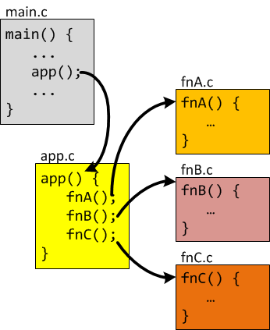
Accelerating Software Functions
Individual functions must be marked for acceleration
  Functions selected for acceleration are "hardware functions“
    Hardware functions can contain sub-functions
  Refactoring required if critical points are not isolated as functions
  Each function becomes an individual piece of IP
OS-based platforms have only one master thread
communicates with all cores
Restrictions
  Only one function per file scope
    Splitting of files may be required to accelerate multiple functions
  Call to a hardware function must reside in a different file scope than the hardware function
  Other tool limitations may apply
    See Vivado HLS tool C/C++ guidelines

Slide 23
Estimating Performance
One of three build configurations: SDEstimate, SDDebug, SDRelease
The Estimate configuration builds a project only up to a point that performance estimates can be determined
  A complete Release or Debug build can take long time
  The SDEstimate configuration shows the impact of moving functions to hardware in only a few minutes
Comparison of hardware-accelerated system with original software-only system is accomplished by producing two separate sets of data, one for each scenario
  The Vivado HLS tool is used to produce data for hardware estimates
  Generated ELF must be run on the actual target to generate data for software estimates
  IDE provides a Report viewer that compares and illustrates the data

Slide 24
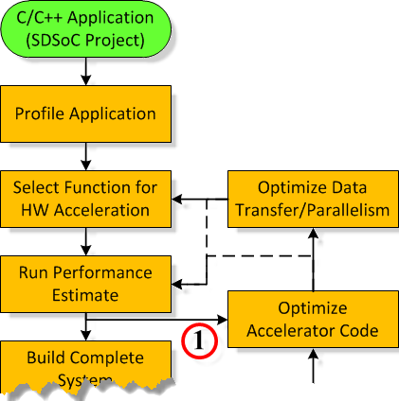
Initial Development Flow
Building the Estimate configuration yields enough
information to fine-tune optimization
First attempts often produce poorer performance
than software alone
  Typical when code has not been refactored and/or annotated
  for acceleration
Recommendation: Initial design iterations should use the
"short" path until performance improvements are seen
  Begin by optimizing code to improve accelerator performance, parallelism, and data flow
  Rebuild to observe impact of changes on estimates
  Repeat cycle until satisfactory results are achieved
Detailed system analysis and fine-tuning should be performed next
  Building and analyzing the full HW/SW system

Slide 25
Building the Complete System
Building a project is where SDSoC does all the heavy lifting
  Three basic methods to run the build process
    Through the IDE, using a makefile, directly from the command line
  It is during this step that SDSoC calls upon its internal framework and several sub-executables to accomplish
    (1) system compilation, (2) system analysis, (3) system generation
Activate the SDRelease build configuration for a fully optimized build
A successful build will result in several output products including the following key items
  Application program in ELF format
  Bitstream (optional)
  SD card image (optional)
  Design projects (e.g. Vivado Design Suite and Vivado HLS tool)

Slide 26
Running the Application
SDSoC development environment requires use of an SD card to run applications for Linux
  Files required to run the application on hardware are grouped together as an SD card image
    First stage bootloader (FSBL), bitstream, and second stage bootloader (SSBL) embedded in a single binary file (BOOT.BIN)
    Linux kernel
    Application ELF
    Other miscellaneous files
  ELF must be explicitly run from the mounted SD card directory
Standalone applications do not require but can use an SD card
  When SD card is used, the SSBL in the binary file is replaced by the application ELF
    Boots directly to the application ELF
  Applications can be run from the IDE using an SDSoC tool Run configuration

Slide 27
Analyzing the Built System
The goal of this step is to analyze the performance of the updated hardware/software system
The same tools and techniques used initially apply here: profiling, instrumentation
  Profiler tool for relative software execution times
  Time-stamping functions provided through SDSoC API (sds_lib)
System consists of hardware and software with additional tools required for complete analysis
  Vivado HLS tool provides reports detailing generated hardware (included with output products)
  Vivado Design Suite can open the generated system hardware design to review additional reports, modify hardware
  SDSoC tool compiler can optionally insert an AXI performance monitor (APM) into the generated system
    APM monitors dataflow between the PS-PL

Slide 28
Optimizing the System
Optimizing the system is broken down into two steps: accelerator and then data flow and parallelism
Optimizing the accelerator consists of refining and/or annotating the hardware function
  Re-factoring code to be more HLS-friendly
  Adding code annotations (i.e., pragmas) that HLS can interpret and use to better optimize the accelerator
For system-level optimizations (data-flow/parallelism) there are several options including
  Using physically contiguous memory
  Using shared memory
  Using multiple instances of the same hardware
  Overriding HLS default behavior

Slide 29
Outline
SDSoC Development Environment
Use Cases
SDSoC Development Flow
SDSoC Project Creation
Summary
Lab1 Intro
Appendix

Slide 30
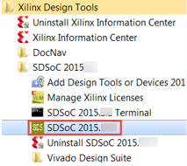
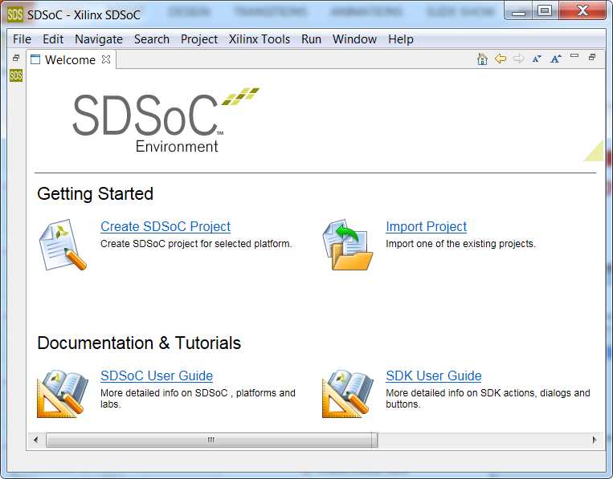
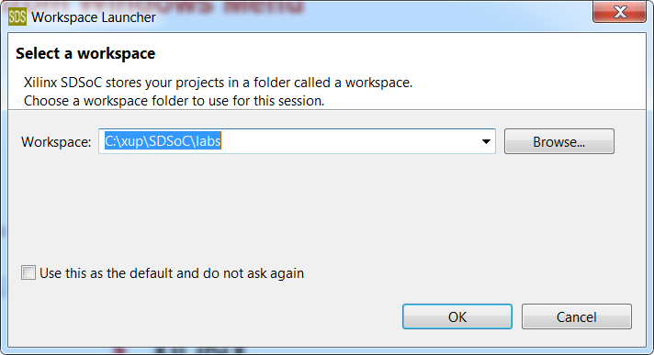
Invoke SDSoC from Windows Menu
3. If workspace empty then Welcome screen appears otherwise projects stored in the workspace are displayed
1. Start SDSoC
2. Select a workspace

Slide 31
Creating, Importing, and Opening Projects
You can create a new project in the selected workspace by clicking on the respective link on the Welcome screen or selecting File > New > SDSoC Project
  Identify project name
  Select target platform
  Select target OS
  Select either available template or an empty project option
You can import an existing project
  Select archive file if the project is in an archived form
  Identify path if the project is saved in a hierarchical directory structure

Slide 32
Project Definition
An SDSoC tool project is a folder in a workspace that contains all project files and tool metafiles
SDSoC tool projects carry some additional properties beyond these general Eclipse-based concepts
  Associated with a specific SDSoC development environment platform
  Built for a specific type of operating system (OS)
Built-in OS support: Linux (default), Standalone (a.k.a bare-metal), and FreeRTOS
An SDSoC development environment platform is a baseline embedded system that the SDSoC tool can build on top of
  Consists of a Vivado Design Suite hardware design targeting a specific board
  Can also include platform-specific software libraries
  Support for several platforms is included with the SDSoC development environment but platforms can also come from third parties

Slide 33
Operating System Support
The output products of an SDSoC tool project vary depending on the targeted OS
For standalone projects
  swstubs folder will include the Xilinx standalone library (libxil)
For Linux projects
  SD card image will include a pre-compiled Linux kernel and root file system
  Pre-compiled kernel contains drivers to communicate with accelerators
For FreeRTOS projects
  Projects will link to a FreeRTOS library supplied by the SDSoC development environment as an extension to the GNU toolchain

Slide 34
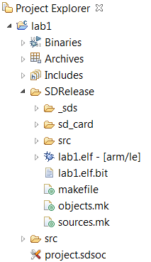
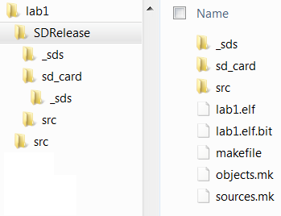
Project Hierarchy
Project Explorer View
  The root folder of a project hierarchy is named after the project itself (lab1)
  Three virtual branches are provided: Binaries, Archives, Includes
    These list executables, libraries, and header files found in or used by the project
  Other branches represent actual folders on the file system: build outputs and source files
  The src folder holds source files
  The final element at root level is the actual SDSoC project file: project .sdsoc
Windows Explorer View
  Hosts real files and directories

Slide 35
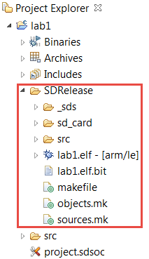
Project Hierarchy (2)
Common to every build folder are several important components
  The compiled application executable is placed at the root of the build folder (lab1.elf)
  Several auto-generated make files used by the IDE to initiate the build process
  The _sds folder is a catch all for everything else
    Reports, files generated by back-end tools (e.g. Vivado Design Suite project), software stubs, etc.
  An sd_card folder that contains the SD card image
    Not strictly an image but rather a collection of files and folders
  A src folder that contains compiled source files (i.e., object files)

Slide 36
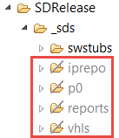
Project Hierarchy (3)
The _sds folder contains several sub-folders
  swstubs
    Software files and stubs generated and supplied by the SDSoC development environment
    Some original source code modified to interface with accelerators
  iprepo
    Repository of cores generated by the Vivado HLS tool (i.e., accelerators)
  p0
    Vivado IPI project and related files, can invoke Vivado by double-clicking on the *.xpr entry
  reports
    Various reports including data motion network
  vhls
    Vivado hls project files for each of the targeted accelerators
Grayed out folders indicate output products generated by independent back-end tools

Slide 37
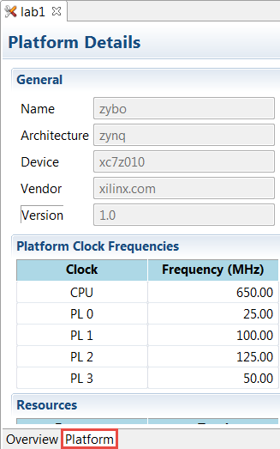
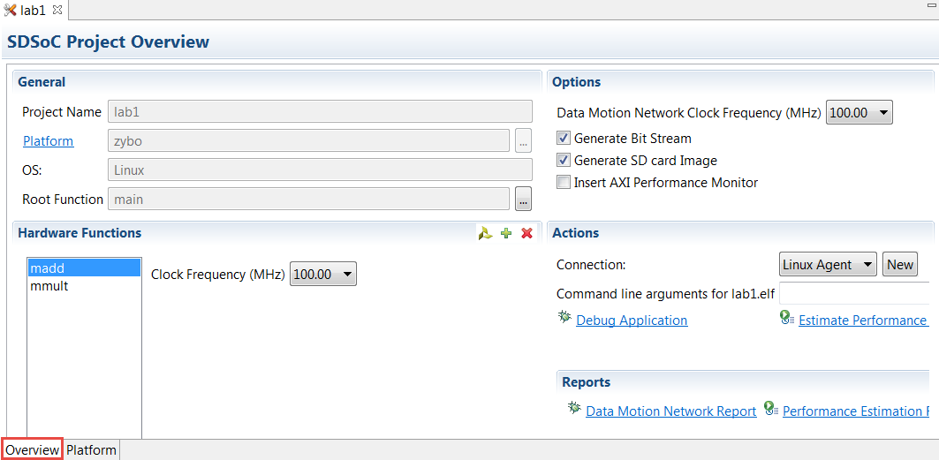
Project Overview
Overview tab
  Select functions which are hardware target
  Select Data Motion network clock frequency
  Other options
Platform tab
  Shows available clock frequencies

Slide 38
Outline
SDSoC Development Environment
Use Cases
SDSoC Development Flow
SDSoC Project Creation
Summary
Lab1 Intro
Appendix

Slide 39
Summary
The SDSoC development environment provides a familiar embedded C/C++ application development experience
Provides infrastructure to combine processing system, accelerators, data movers, signaling, and drivers
Benefits of using SDSoC include
  Shorter development cycles
  Simplified interface and partitioning between hardware and software
SDSoC may be suitable for video, communication, image and digital signal processing applications where either large amount of data and/or higher throughput is required
SDSoC uses Vivado HLS, Vivado IPI, SDK tools
SDSoC project creation involves identifying workspace, project name, selecting target platform, selecting OS, and either selecting pre-defined application templates or creating empty application

Slide 40
Outline
SDSoC Development Environment
Use Cases
SDSoC Development Flow
SDSoC Project Creation
Summary
Lab1 Intro
Appendix

Slide 41
Lab1 Intro
Introduction
  This lab guides you through the process of using SDSoC to create a new project using available templates, mark a function for hardware implementation, build a hardware implemented design, and run the project on either ZedBoard or ZYBO board
Objectives
  Create a new SDSoC environment project for your application from a number of available platforms and project templates
  Mark a function for hardware implementation
  Build your project to generate a bitstream containing the hardware implemented function and an executable file that invokes this hardware implemented function
  Test the design in hardware

Slide 42
Outline
SDSoC Development Environment
Use Cases
SDSoC Development Flow
SDSoC Project Creation
Summary
Lab1 Intro
Appendix

Slide 43
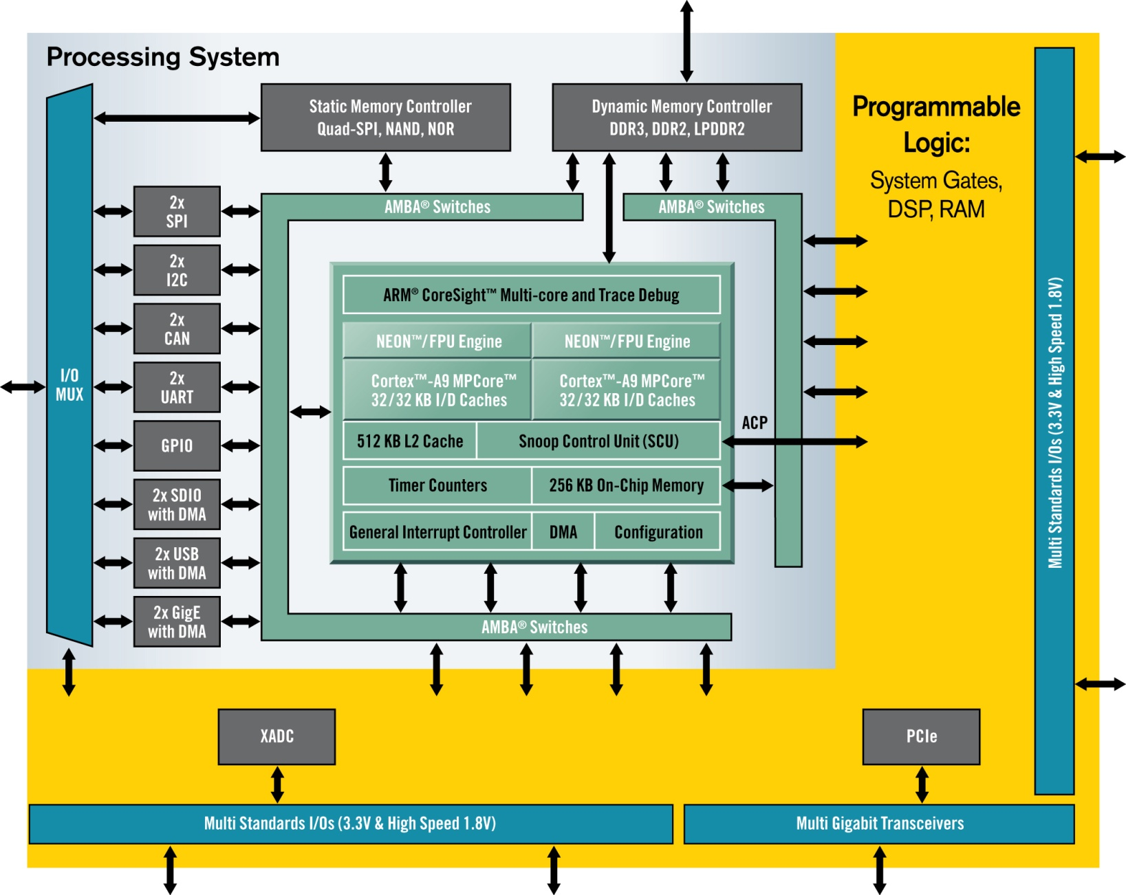
Advantage of FPGA Hardware Accelerators
Processing System (PS)
  Two ARM® Cortex™-A9 with NEON™ extensions
  Floating Point support
  Up to 1 GHz operation
  L2 Cache – 512KB Unified
  On-Chip Memory of 256KB
  Integrated Memory Controllers
  Run full Linux
Programmable Logic (PL)
  28K-444K logic cells
  High bandwidth AMBA interconnect
  ACP port - cache coherency for additional soft processors
1-2
Gops
10-1000+ Gops
Programmable Logic Provides Superior Performance

Slide 44
Example: Communications Algorithm
Customer Data
  Function names redacted
  CPU cycles to complete the function
Function | Software (cycles) | Hardware (cycles) | Speed Up
Function 1 | 338~258 | 61 ~ 30 | 5-8x
Function 2 | Case type： 1: 351 2: 357 3: 448 | Case type： 1: 13 2: 13 3: 13 | 27-37x
Function 3 | 277~13 | 13 | 1-21x
Function 4 | 1351~492 | 739~106 | 2-4x

Slide 45
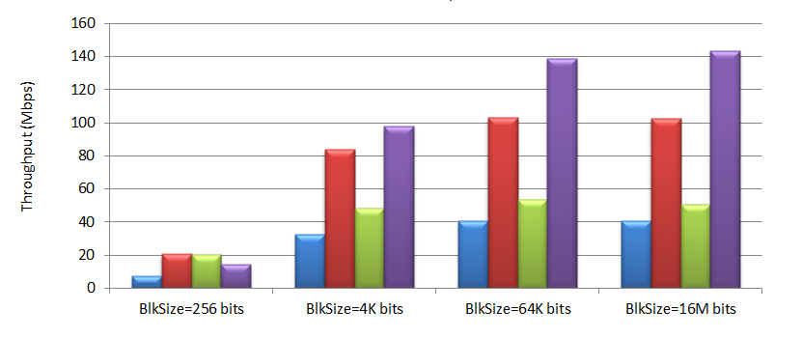
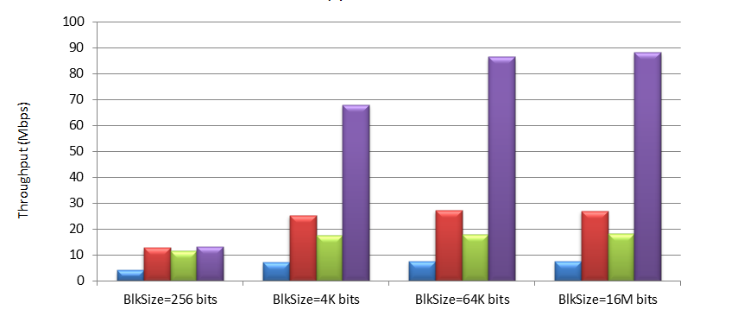

Example: Communications Algorithm
EEA Block
ZUC encryption algorithm
  Part of the 3GPP LTE EEA/EIA-3
EEA performance
  50% with 16M data set
EIA performance
  4X with 16M data set
Smaller data sets
  Typically show less improvement
EIA Block

Slide 46
Example: Digital Pre-distortion
ARM NEON function intrinsics
  Low-level ARM-A9 programming
  Sometimes software optimization is good enough (5X in this case)
  HLS is better but uses HW
Data transfer from GP port through AXI interconnect and FIFO
Update Time (ms)
70x speedup for the
main feedback
update function
Hardware | FF | LUT
AXI Infrastructure | ~300 | ~300
Accelerator | 2552 | 2605

