Slide 1
Operating Systems – Memory management practice
Péter Györke
http://www.mit.bme.hu/~gyorke/
gyorke@mit.bme.hu
Budapest University of Technology and Economics (BME)
Department of Measurement and Information Systems (MIT)
The slides of the latest lecture will be on the course page. (https://www.mit.bme.hu/eng/oktatas/targyak/vimiab00)
These slides are under copyright.

Slide 2
The main blocks of the OS and the kernel (recap)
System processes
User processes
Non-protected
(user)
System libraries
Systemcall interface
I/O operations
Communications
Protected
(system)
Process management
IT handler
Memory manager
Device managers
Loader
Scheduler
Hardware devices

Slide 3
Data structures of the tasks (recap)
Activities performed by programs
  Tasks have state and life-cycle
  Tasks have own and administrative data structures
Program data (in the task’s memory range)
  Code
  Static allocated data
  Stack: temporary storage, e.g. for function calls
  Heap: runtime (dynamic) allocated memory space
Administrative data (managed by the kernel)
  Task (process, thread) descriptor
  Unique ID (PID, TID)
  State
  Context of the task: the descriptor of the execution state
    Program counter, CPU registers
    Scheduling information
    Memory management state (MMU state)
  Owner and permissions
  I/O state information
Stack
Free memory
Heap
Static data
Code
PID
State
Context
Permissions
I/O state
…

Slide 4
Separation of the tasks (abstract virtual machine concept)
The ideal scenario: every task runs independent of each other
  No effects on other tasks
  It seems they running on a separate machine (resources)
In the reality: not enough resources for each task
  They have to share the resources (CPU, memory, etc.)
  Goal: the task (and the user) don’t notice this
  The kernel provides an abstract virtual machine for the tasks (virtual CPU and memory)
Complex activities require more than one task: this makes the situation more complex
  Communication (IPC) and cooperation schemas have to be provided

Slide 5
Address translation and paging
The tasks of the Memory Management Unit (MMU)
  Address translation: from CPU address to physical RAM and I/O addresses
Address translation in virtual MM
  The tasks reach the whole CPU memory range
    This is the virtual range
      E.g.: x86-64: 2⁴⁸ = 256 terabyte
    The physical memory is only a fragment of this
      It may addressed with the physical memory address range
    If there are no sufficient physical memory,
    the rest will be stored on the HDD
The memory organized in pages
  The virtual range is divided into equal size pages
  The physical memory is also divided into same size frames
  The pages stored on the HDD in blocks
  Page table: association between physical frames, virtual pages and HDD blocks
    Valid (=1, it’s in the physical memory)
    Dirty (=0, the data is the same as the stored version on the HDD)
    Accessed (=1, recently used page)
  Translation Lookaside Buffer (TLB): accelerating the address translation
Physical memory
Virtual memory
Address translation
HDD

Slide 6
Address translation and page table
The common hardware uses hierarchical page table
  The page table is also divided into pages
  Relatively fast
  Not stored entirely in the memory
  On 64-bit systems it can be tree (4-6 levels)
  It is used by ARM and x86 architectures also
The steps of address translation
  Subdividing addresses
    Page number index
    Offset
  The physical frame is identified by the index
  The offset is added to the index
Address (task) separation
  Usually separate page tables for tasks
    The page table is part of the tasks context
Virt. address
Phy. address
page num. | offset
1 | 489
start address | offset
43 | 489
Valid?
1 | 43 | Y
2 | 43 | N
3 | - | N
4 | - | N
5 | 57 | Y
6 | - | N
7 | 36 | N
8
Single level page table

Slide 7

Checking the memory map of a process (LINUX)
Check the global memory usage: free
Linux is trying to allocate memory for further requests: buffers and cached columns → it seems like the free memory is low

Slide 8
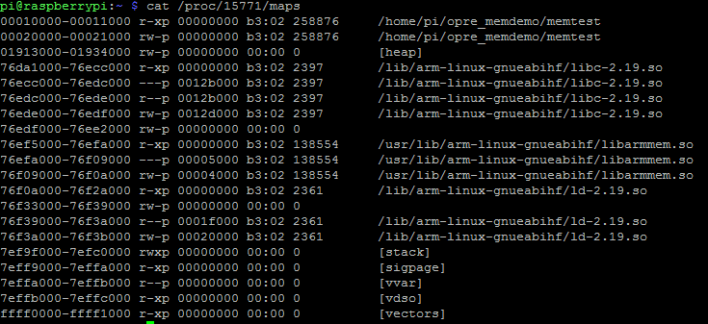
Checking the memory map of a process (LINUX)
View the memory map of a process: cat /proc/<PID>/maps
Permissions
r = read
w = write
x = execute
s = shared
p = private (copy on write)
start-end perm offset device inode path

Slide 9
Checking the memory map of a process (LINUX)
Running a simple test program: memtest.c
Compiling the code: gcc memtest.c -o memtest
The file memtest is the executable
Run it: ./memtest
It will print its PID, so we can observe the memory map file
It will allocate global and local variable and the pointers (memory addresses) are printed
Global variables → heap
Local variables → stack

Slide 10
The data structures of virtual memory management
Page frame data (pfdata) entry (kernel)
  Every frame has one entry, indexed by the starting address of the frame
  State: free, used, under DMA op., etc.
  Reference counter: how many task uses this frame
Kernels page table entry (part of task’s context)
  There fields used by the MMU HW
    Index of the page
    Frame identifier (where is (was) the page in the RAM)
    Valid bit: =1 if the page is in the RAM
    Dirty bit: =1 if the page is written since it is in the RAM
    Accessed bit: =1 if the page is „recently” accessed
    Read-only bit
  There are fields which not managed by the MMU (HW dependent)
    Page state: in RAM, on disk, fill-on-demand
    Task ID, copy-on-write bit, permissions, etc.
Disk block descriptor (kernel)
  The disk ID: which file on which disk
  Block index
  Type: swap, fill-on-demand

Slide 11
References between date structures and address translation
Virt. address
Phy. address
page num. | offset
2 | 489
start address | offset
43 | 489
 | frame | valid |  | device | idx
1 | 43 | Y |  | sda1 | 5
2 | 43 | N |  | swap | 3
3 | - | N |  | sda1 | 6
4 | - | N |  | ZF
5 | 57 | N |  | swap | 36
6 | 36 | N |  | swap | 13
7 |  | N
8
addr. | state | acc | dirty
36 | free | 0 | 0
43 | used | 1 | 0
57 | used | 2 | 1
Page frame data
Page table and disc block desc.

Slide 12
Page replacement algorithms – introduction
A page has to be loaded, but there are no free frames
  A used frame has to be picked, which will be moved to the swap space and mark as free
The picking based on
  Accessed bit: Is it used „recently”?
  Dirty bit: Is the contents modified?
  The allocation time of the frame
  The latest access time of the frame
  Reference counter: how many task uses this frame?
The properties of page replacement algorithms
  Ideal solution: seeing the future
    It is similar to the estimation of the CPU burst of a task
    In practice, the prediction is based on the behavior in the past
  The frame to swap may be chosen from the actual task’s (local) range or from the global range
  Algorithms (details on following slides)
    FIFO: the page loaded first will be replaced first
    Second chance (SC): oldest and not accessed page
    Least Recently Used (LRU): the oldest accessed page
    Least Frequently Used (LFU): the most rarely used page
    Not Recently Used (NRU): Non accessed and non modified page

Slide 13
Test problem 1
Page table |  |  |  | Disc block desc.
 | frame | valid |  | device | idx
1 | 43 | 0 |  | sda1 | 5
2 | 43 | 1 |  | swap | 3
3 | - | 0 |  | swap | 6
4 | - | 0 |  | ZF
5 | 57 | 0 |  | swap | 36
6 | 36 | 0 |  | swap | 13
Page frame data
addr. | state | acc | dirty
36 | free | 0 | 0
13 | used | 0 | 0
43 | used | 1 | 0
57 | used | 1 | 1
1) Which page is stored in frame 43?
2) Where is the content of page 6?
3) What’s stored in frame 13?
4) What happens when a task start a read operation from page 4?

Slide 14
Test problem 1
Page table |  |  |  | Disc block desc.
 | frame | valid |  | device | idx
1 | 43 | 0 |  | sda1 | 5
2 | 43 | 1 |  | swap | 3
3 | - | 0 |  | swap | 6
4 | - | 0 |  | ZF
5 | 57 | 0 |  | swap | 36
6 | 36 | 0 |  | swap | 13
Page frame data
addr. | state | acc | dirty
36 | free | 0 | 0
13 | used | 0 | 0
43 | used | 1 | 0
57 | used | 1 | 1
5) Modify the tables according to the 4) question!
Page table |  |  |  | Disc block desc.
 | frame | valid |  | device | idx
1 | 43 | 0 |  | sda1 | 5
2 | 43 | 1 |  | swap | 3
3 | - | 0 |  | swap | 6
4 | 36 | 1 |  | ? | ?
5 | 57 | 0 |  | swap | 36
6 | 36 | 0 |  | swap | 13
Page frame data
addr. | state | acc | dirty
36 | used | ? | 0
13 | used | 0 | 0
43 | used | 1 | 0
57 | used | 1 | 1

Slide 15
Test problem 1
Page table |  |  |  | Disc block desc.
 | frame | valid |  | device | idx
1 | 43 | 0 |  | sda1 | 5
2 | 43 | 1 |  | swap | 3
3 | - | 0 |  | swap | 6
4 | 36 | 1
5 | 57 | 0 |  | swap | 36
6 | 36 | 0 |  | swap | 13
Page frame data
addr. | state | acc | dirty
36 | used | 1 | 0
13 | used | 0 | 0
43 | used | 1 | 0
57 | used | 1 | 1
5) In this system, the pages were allocated in the order: 57, 43, 13 and 36. A task want’s to read the page 3. There are no more free frames. Which frame will be replaced?
  A) With FIFO page replace alg.?
  B) With Second Chance alg.?

Slide 16
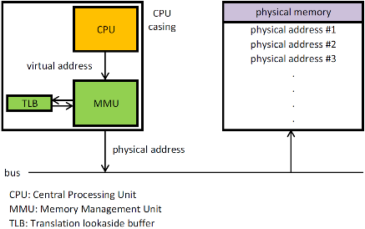
Further questions
What technique can prevent the replacement of a recently allocated page?
Which unit performs the address translation when a page is valid?
en.wikipedia.org/wiki/Memory_management_unit#/media/File:MMU_principle_updated.png

Slide 17
Page replacement algorithm practice problems
FIFO

Slide 18
Page replacement algorithm practice problems
Second Chance (SC)

Slide 19
Page replacement algorithm practice problems
Second Chance (SC)

Slide 20
Page replacement algorithm practice problems
Least Recently Used (LRU)

Slide 21
Page replacement algorithm practice problems
Least Recently Used (LRU)

Slide 22
Page replacement algorithm practice problems
Least Recently Used (LRU) with 5 long Page Locking (PL)

