Slide 1
Operating Systems Internals – Task scheduling
Péter Györke
http://www.mit.bme.hu/~gyorke/
gyorke@mit.bme.hu
Budapest University of Technology and Economics (BME)
Department of Measurement and Information Systems (MIT)
The slides of the latest lecture will be on the course page. (https://www.mit.bme.hu/eng/oktatas/targyak/vimiab00)
These slides are under copyright.

Slide 2
Task scheduling (recap)
Single level scheduling
  FIFO, RR, SJF, SRTF, Priorities
  Starvation
  Measures: avg. waiting time, turnaround time, CPU utilization
Multilevel scheduling
  Multilevel static scheduling: fixed priorities (no queue change)
  Multilevel dynamic scheduling: dynamic priorities (better in practice, because the tasks may change their nature)
Multiprocessor scheduling
  Processor affinity
  Symmetric
    Local queues for every processor
    Push-pull task transfer
  Asymmetric
    Kernel gets a whole CPU

Slide 3
The main blocks of the OS and the kernel (recap)
System processes
User processes
Non-protected
(user)
System libraries
Systemcall interface
Protected
(system/kernel)
I/O operations
Communications
Process management
IT handler
Memory manager
Device managers
Loader
Scheduler
Hardware devices

Slide 4
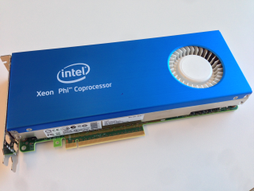
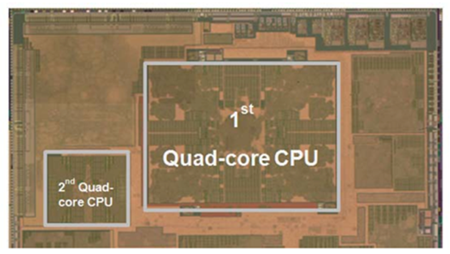
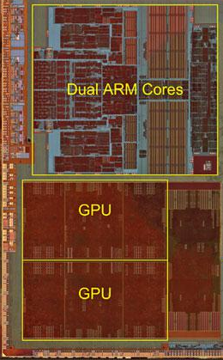
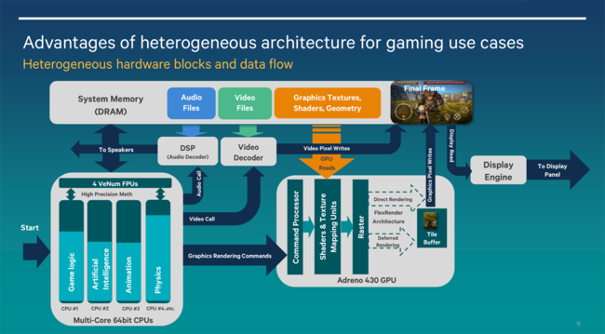
Heterogeneous multiprocessor systems

Slide 5
Heterogeneous multiprocessor systems
Current trend
  Energy efficiency (phones, tablets)
  Form factor (multiple functions on one chip)
  Hardware accelerators for extensive computations
  CPU + GPU in gaming consoles
Examples
  ARM big.LITTLE: a high performance and a low-power core together
    E.g.: Snapdragon 810, Nvidia Tegra X1, MediaTek MT6595, etc.
  CPU + GPU (GPGPU) systems
    AMD HSA and hUMA: integrated CPU and GPU with shared memory (e.g. PlayStation 4)
    Intel HD graphics
  CPU + HW accelerator
    Intel MIC (Many Integrated Core) architecture, e.g.: Xeon Phi (60+ CPU core)
    FPGA-based, e.g.: IBM CAPI HW accelerator with coherent memory management
      IBM Power8 CPU + Altera FPGA (Intel buys them Q4 2015)
    GPGPU systems may categorized here also for parallel (non-graphics) processes

Slide 6
Common questions of heterogeneous multiprocessor systems
Memory management (coherent or distributed)
  The processors using a shared memory
    AMD hUMA (heterogeneous UMA)
    IBM Power 8: Memory sharing is performed through PCIe bus
  Distributed systems
    Intel Xeon Phi: every card has its own memory, it is available through the network
    GPGPU: the GPU usually uses dedicated memory
Instruction Set Architecture (ISA)
  Homogeneous (single ISA)
    Every unit has the same IS → easy to move tasks
  Heterogeneous – problematic
    Is there any binary compatibility?
    The kernel can’t manage it → only used in custom (usually embedded) systems
Who manages the heterogeneous architecture?
  The CPU? Automatically migrate the tasks between processing units.
  The OS scheduler? It knows more about the tasks, moves them to the appropriate location.
  The applications? The tasks are forwarded to the appropriate subsystems.

Slide 7
Schedulers in practice: Windows
Symmetrical, multiprocessor with local RTR queues
  It manages the soft and hard affinity
Multilevel, priority, time sharing, fully preemptive scheduler
  16 „real-time” levels (priorities: 16-31)
  16 dynamic level (0-15, 0 is reserved for system)
  The user can slightly modify the priorities
    Low – below normal – normal – above normal – high – realtime
  The scheduler may boost the priority in some cases
    If a task finishes waiting for an I/O operation (better response time)
    If a tasks gets an input from the user interface (better response time)
    If a task is waiting for a long time (to avoid starvation)
    Priority inversion is managed (see random boost)
    Multimedia Class Scheduler Service boosts the MM and gaming processes
Resource allocation: Distributed Fair Share Scheduler (on Windows servers
  Separate scheduler for accessing other resources
    Levels: Premium, Standard, Basic
  User Sessions assigned with a CPU quota
    Fair service for the remotely logged in users

Slide 8
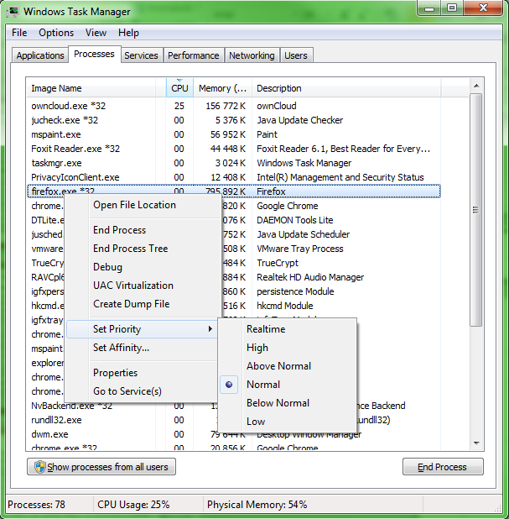

Slide 9
Schedulers in practice: Linux
Before v2: traditional UNIX scheduler (as seen before)
Before v2.4 kernel
  Scheduling classes: real-time, non-preemptive, normal
  Complex scheduling with O(N) (linear) complexity
  Single scheduling queue (no multiprocessor support)
  Kernel is non-preemptive
Kernel v2.6
  O(1) scheduler (as the call it)
  Distributed queues for each processor
  Multilevel feedback with priorities and time-sharing
  140 priority level: 0-99 „real-time” static, 100-139 time-sharing, dynamic
  „active” has time slice, „expired” (preempted) queues on every level
  Priority is recalculated when moving from active to expired
  If the active queue is empty, the expired become active (pointer operation)
  Tasks waiting for a long time gets a little „bonus”
From kernel v2.6.23 CFS (Completely fair scheduler)
  See next slide…

Slide 10
Linux CFS (Molnár Ingo)
O(log N) complexity
Instead of queues, the tasks are stored in a special tree structure
  Red-black tree: self balancing search tree
    Smaller values on the left, higher values on the right
    Search in this is tree has the complexity of O(log N)
    If the tree is shallow, the insertion is also efficient
Priority calculation
  Virtual runtime (vruntime) assigned to each task
    It tries to distribute runtime in a fair way
    During execution vruntime is increasing, depending of the priority
  The red-black tree is constructed based on vruntime
  The tasks with
    Small vruntime: gets the CPU earlier
    Large vruntime: loses the CPU earlier

Slide 11
Solaris UNIX
Properties
  The scheduling is thread based
  Fully preemptive kernel
  Multiprocessor systems and virtualization are supported
Multiple scheduling classes
  Time-sharing (TS): scheduling by waiting/running times
  Interactive (IA): like above, but enhance the priority of the active window
  Fixed priority (FX)
  Fair share (FSS): CPU resources are assigned to a process group
  Real-time (RT): this level provides the shortest latency
  Kernel threads (SYS): highest level except the RT

Slide 12
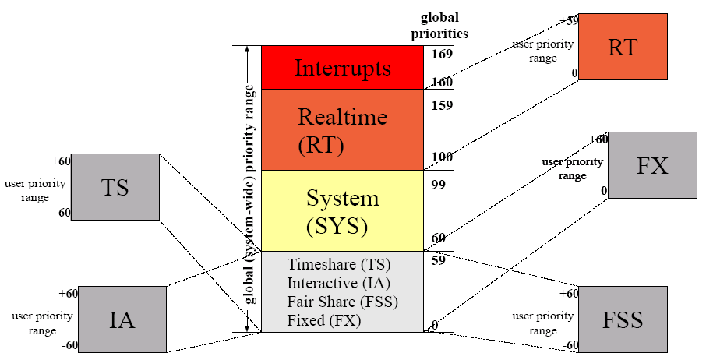
Scheduling classes of Solaris UNIX

Slide 13
Computation examples for simple schedulers
Schedulers
  FCFS: simple, based on FIFO (cooperative)
  RR: time-sharing (after the time slice is up, gets the next task from FIFO)
  SJF: ordering tasks by estimated CPU-burst (cooperative)
  SRTF: preemptive SJF
  PRI: ordering tasks by priority
Measuring numbers for evaluation
  Response time
  Waiting time – elapsed time in non running state (waiting, ready to run)
  Execution time – elapsed time in running state

Slide 14
Simple scheduler examples
Show the operation of simple schedulers on Gantt chart and calculate the avg. waiting time!
  Methods: FCFS, SJF, RR (TS=2, TS=6)
  Tasks [Start, CPU-burst]
    A [0, 6]
    B [0, 3]
    C [0, 3]

Slide 15
FCFS example

Slide 16
SJF example

Slide 17
RR (TS=2) example

Slide 18
RR (TS=6) example

Slide 19
Practice example for static multilevel scheduler
The scheduler
  Static priorities: 0..9 (0 is the highest)
  Levels:
    Level 1: 0-4 non preemtive SJF
    Level 2: 5-9 preemtive RR, time slice: 2
  To calculate: running order and avg. waiting time
Paramters of the tasks
  Priority
  Starting (arrival) time
  CPU-burst
Tasks [Pri, Sta, CPU]
  A [3, 0, 5]
  B [4, 0, 4]
  C [6, 5, 8]
  D [6, 7, 8]

Slide 20
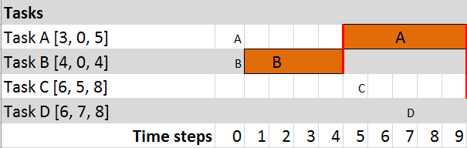
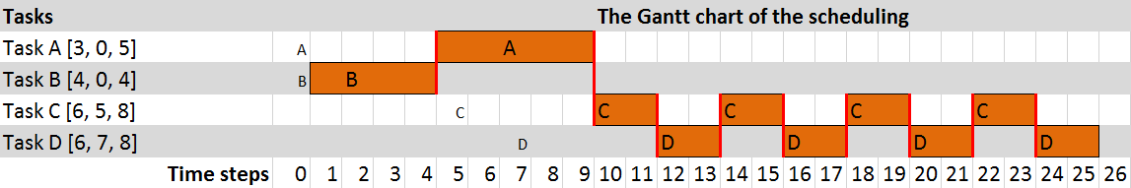
Gantt chart (static multilvel)

Slide 21
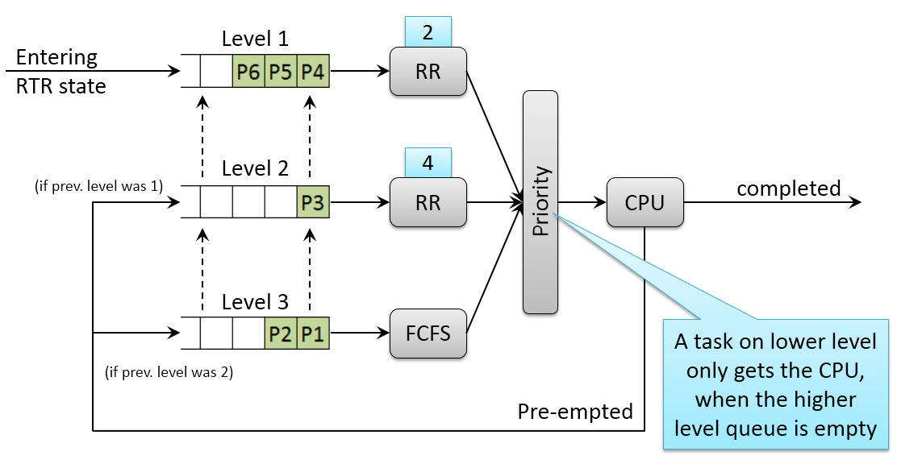
MFQ (Multilevel Feedback Queue) example
3 levels:
Tasks [Start, CPU-burst]
  A [0, 5]
  B [0, 5]
  C [3, 13]
  D [10, 11]

Slide 22
Gantt chart (MFQ)

