Slide 1
Operating Systems Internals – Task scheduling
Péter Györke http://www.mit.bme.hu/~gyorke/
gyorke@mit.bme.hu
Budapest University of Technology and Economics (BME)
Department of Measurement and Information Systems (MIT)
The slides of the latest lecture will be on the course page. (https://www.mit.bme.hu/eng/oktatas/targyak/vimiab00) These slides are under copyright.

Slide 2
The basics of task management (recap)
The OS serves the user and system tasks
I/O intensive tasks
CPU intensive tasks
Memory intensive tasks
The OS don’t know the nature of the tasks in advance
User expectations can be various
Waiting time, turnaround time, response time, throughput, CPU utilization %
Deterministic, small overhead
Task: a program during execution
Life-cycle: the sequence of state transitions from the start
Abstract virtual machine: virtual CPU and memory for the tasks
Process: has it’s own memory range, contains threads
Thread: sequential task, may share memory with other threads
The role of the scheduler
Controlling the transition: ready-to-run -> run
Event (interrupt) driven
Task change is performed very often in a current system
The overhead of the scheduling and the task (context) change should be minimal

Slide 3
The main blocks of the OS and the kernel (recap)
System processes
User processes
Non-protected
(user)
System libraries
Systemcall interface
Protected
(system/kernel)
I/O operations
Communications
Process management
IT handler
Memory manager
Device managers
Loader
Scheduler
Hardware devices

Slide 4
The goals and temporal properties of the scheduler
The scheduler has to decide which task should run
Managing the ready-to-run and currently running tasks
Selects the next one which enters the run state (gets the CPU)
This decision is based on system and task properties
Where the tasks are selected from?
Short term (or CPU scheduling)
Selects a task from the ready-to-run queue
The operation interval is usually in the range of 1-100 ms
We will examine this type of scheduler later
Long term
Starting and stopping jobs (tasks or task groups)
Usually in the user space (e.g. UNIX cron)
Operation interval: hours, weeks, months
Medium term
Some tasks are pulled out from the short term scheduler temporarily
It can enhance system performance
The user also can initiate it: pause specific tasks
Operation interval: minutes, hours

Slide 5
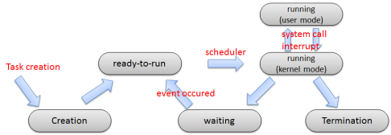
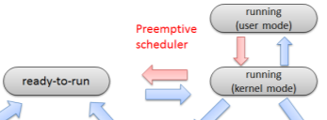
Short term scheduler in the kernel (recap)
A modern OS is event driven
When a task can only give up the right of running voluntarily -> Cooperative (non-preemptive) scheduler
A preemptive scheduler can take away the CPU from a running task

Slide 6
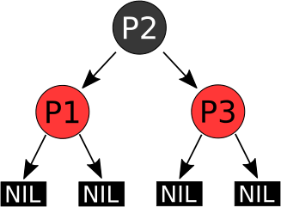
The data structures and complexity of scheduling
Managing (registering) the tasks in different states can be done with:
Queues (typical)
The tasks are in a linear data structure
FIFO: First In First Out
List: insertion or taking out can be performed at any index
Tree structure (e.g.: Linux kernel 2.6.23+)
Iteration is faster than on a queue
E.g.: red-black tree (see Theory of Algorithms subject)
The complexity of a scheduler
Important aspect (runs frequently)
The complexity of data manipulations worst case
Put to and get from FIFO: O(1) – constant
Seek from and put to chained-list: O(N) – linear
Seek from and put to red-black tree: O(log N) – logarithmic
The complexity of other parts of the scheduler: O(1) – constant
Theoretical and practical complexity usually not the same

Slide 7
Simple scheduling algorithms (introduction)
Definitions
Tasks contains CPU and I/O operations
CPU-burst: sequence of instructions executed on the CPU by a task
I/O burst: the task waits for an I/O operation
See CPU/IO intensive tasks…
States of tasks
Running (R), ready-to-run (RTR) and waiting (W)
The schedulers task to manage the R ↔ RTR state transitions
For the first time, we examine the single processor scheduling
The operation of the scheduler can be visualized with a Gantt-chart:
Running task:
P1
P2
P3

Slide 8
A scheduling example
Like in a strategy game
Task
Occupy/defend targets
Different importance (castle vs. mine)
The processing unit
Soldiers
The scheduler
Players
Temporal properties
Long term: when to play?
Medium term: break for dinner
Short term: where to go?
The attack/defense
Preparation (I/O burst)
Combat (CPU burst)

Slide 9
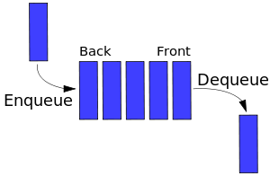
First Come First Served (FCFS)
Data structures and operations
FIFO for the ready-to-run (RR) tasks
An entry can be enqueued at the end and dequeued on the front
Scheduling algorithm
When a running task gives up the right of running, the scheduler choose the task which is waiting for the longest period
RTR queue
Creation
CPU
Termination

Slide 10
Simple FCFS example
The tasks are arriving sequentially into the state RTR
The scheduler executes them in the order of arrival
The scheduler don’t know the CPU-burst duration in advance

Slide 11
Evaluation of the FCFS scheduler
Properties
Cooperative scheduler (non-preemptive)
Very simple data structure and algorithm
Algorithmic complexity (insertion, seek)
O(1)
Overhead
minimal
Quality of service, problems
What happens when a long CPU burst task runs?
Convoy-effect: The RTR tasks are jammed behind the long CPU burst R task
There are some I/O intensive tasks, but they won’t entering into waiting state
This method results higher average waiting time
Practice example
Tasks arriving in order: P1…P3, CPU bursts: P1: 24, P2: 3, P3: 3
How long is the average waiting time?
Further thoughts (for home)
How can we evaluate this scheduler when all tasks are I/O intensive?

Slide 12
Practice

Slide 13
How to address these the problems of FCFS?
Interrupt the tasks with long CPU bursts
The convoy-effect disappears
It is expected: shorter average waiting time
The scheduler becomes preemptive
The algorithmic complexity stays the same
→Round-robin scheduling (RR)
Execute the task first with shorter CPU burst
The convoy-effect disappears
The I/O intensive tasks enters quickly into waiting (W) state
From the CPU intensive tasks, the shorter burst tasks runs quicker
It is expected: shorter average waiting time
The scheduler stays cooperative (non-preemptive)
The algorithmic complexity is higher → more complex data structure
Higher overhead
→ Shortest job first scheduling (SJF)

Slide 14
Round robin (RR) scheduling
A task loses the right of running when a specified time slice is over
Data structure
RTR tasks in a FIFO queue
Algorithm
When a task ends or the time slice is up, choose the task with the longest waiting time from the FIFO (from the front of the queue) and put the running task into RTR state to back of the queue
Time slice
00:15
RTR queue
Creation
CPU
Termination
Time slice is up
Gives up running
Waiting

Slide 15
Evaluation of the RR scheduler
Properties
Preemptive scheduler (there are non-voluntarily task changes)
Very simple data structure and algorithm
Algorithmic complexity (insertion, seek)
O(1)
Overhead
Minimal, depends on the time slice specification
Quality of service, problems
Better avg. waiting time (compared to FCFS), but non optimal
How long the time slice should be? – It has great influence on the performance
Too long → It becomes an FCFS scheduler
Too short → Too many context changes, higher overhead
Practice example
Tasks arriving in order: P1…P3, CPU bursts: P1: 24, P2: 3, P3: 3
How long is the average waiting time if the time slice is 2, or 6?
Further thoughts (for home)
Define the average waiting / turnaround time in the function of the time slice

Slide 16
Practice

Slide 17
Shortest job first (SJF) scheduling
It chooses the task with the shortest CPU burst
Data structure
The RTR tasks are in an list, which is ordered by the CPU bursts
Insertion: any position according to the CPU burst
Acquiring: from the front of the list
Algorithm
If a task ends or gives up the CPU, choose the task from the front of the list(this task has the shortest CPU burst)
It has a preemptive version: Shortest Remaining Time First (SRTF)
There is a time slice, like in RR
See later
When a task enters RTR state, it will be inserted into the appropriate location in the list
CPU
Termination
Creation
Gives up running
Waiting

Slide 18
Evaluation of the SJF scheduler
Properties
Cooperative scheduler
It has a preemptive version: SRTF
More complex data structure (a list ordered by CPU burst)
Algorithmic complexity (insertion)
O(N) – we have to find the appropriate place in the list
Overhead
More than FCFS and RR schedulers
Quality of service, problems
Proven: it is optimal regarding to the waiting and turnaround time
Difficulties: How can we know the task’s CPU burst?
We don’t know: it is based on estimations
In embedded systems some task has predefined CPU burst
Practice example
Tasks arriving in order: P1…P3, CPU bursts: P1: 24, P2: 3, P3: 3
How long is the average waiting time?
Further thoughts (for home)
Calculate the waiting time with different CPU burst estimations!

Slide 19
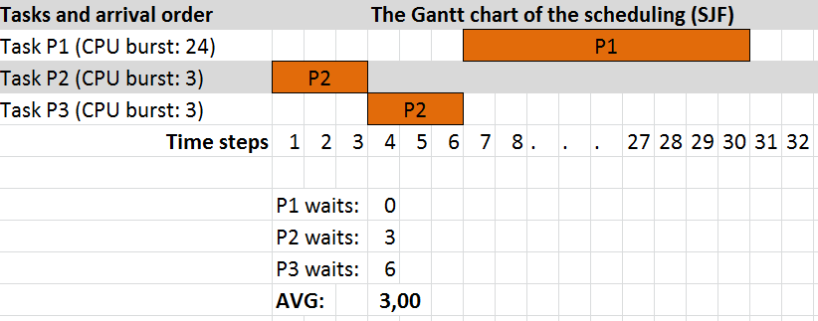
Practice

Slide 20
Further scheduling attributes
Goal: enhance the global performance
The task are not the same (foreground vs. background tasks)
There are other aspects which should considered by the scheduler
We can introduce priorities for the tasks
The previous schedulers ignores such properties of the tasks
Solution: provide more information to the scheduler
Simple way: priority
A integral number assigned to each task

Slide 21
Schedulers with priority
Common problem in previous schedulers
Cannot distinguish between task according to their importance
Common expectations are cannot fulfilled
Kernel tasks (e.g.: interrupt handler task) are more important
The user tasks are not equal (multimedia, real-time, background task,…)
Assign priorities
Priority is a number according to the expected running order of the RTR tasks
No standard for the value range, usually divided into ranges
UNIX: 0-49 kernel tasks, 50-127 user tasks
Windows: 16-31 static priority tasks, 1-15 dynamic priority tasks
Priority can be changes by the task and the user (in a constrained way)
It can be increased or decrease according to the actual permissions of the task owner
Priority determination
External priority: determined by the user or the task
Internal priority: determined by the kernel (e.g. scheduler, resource mgmnt.)
Priorities can be static (constant during the task’s life-cycle) and dynamic

Slide 22
Starvation: common problem of schedulers with priority
If the tasks aren’t equal
The one with higher priority comes ahead of lower priorities
If there are many tasks with higher priority: the task never gets the CPU
This is called starvation or indefinite blocking
If this is allowed, there may tasks which are never gets the CPU
How can we avoid starvation?
It cannot avoided with static priorities
We should use dynamic priorities
The priority of a starving task should be increased slowly
This called aging
The tasks in RTR state has a constantly increasing priority, proportional to the time spent in the queue (waiting time)
Sooner or later it will come ahead the higher priority tasks and gets the CPU

Slide 23
Multilevel scheduling
Problems with the previous schedulers
The description capability of the priority is constrained
Not much information can be „crammed” in one number
The expectations for tasks can be different, one scheduler cannot fulfill all of them
The different schedulers can be optimal for different types of tasks
Solution: Multilevel scheduling
If tasks can be categorized, they can be ordered in different queues. Every queue can have it’s own scheduling algorithm, which is the most appropriate for the tasks in the queue.
The scheduling queues should also be scheduled
Which queue we choose the next task from?
Every queue may have a time slice (RR)
The more important level may have a longer time slice
Priorities can be assigned to the scheduling queues
Starvation may appear
Starvation can be avoided if the tasks are allowed to change the current scheduling queue
More complex: an algorithm is needed for stepping up and down the tasks

Slide 24
Static multilevel queues
The tasks are assigned to a queue in a static way
There’s no changing between queues (static priority)
The assignment is based on the priorities of the task
The priority stays the same till the completion of the task
The different queues are defined by the nature of the tasks
Real-time operation
Serving system tasks
Providing interactive operation (user session in foreground)
Batch processing (long CPU burst, but non time critical tasks)
System statistics, logs, other tasks with low importance
Advantages
Different levels, can be managed by different (appropriate) scheduling algorithms
The levels are managed in a simple way (no level changing)
Disadvantages
Due to static priorities the starvation appears
The „nature changes” of the tasks are unmanageable
E.g.: a batch job may become interactive for a short time (Asks something from the user)

Slide 25
Static multilevel scheduler
Level 1
8
RR
Assign queue, based on priority
Level 2
16
Choose task to run
Entering
RTR state
RR
CPU
Level 3
FCFS
Next time: dynamic multilevel queues…

Slide 26
Summary
The scheduler chooses the next task to run
Short term (we learned about this), medium and long term
Basic properties
Data structure
Considered task properties
Decision algorithm
Complexity and overhead
Simple schedulers
FCFS: simple, but it may perform badly
RR: it is widely used, good response time, moderate overhead
SJF and SRTF: decision based on the task’s CPU burst, optimal waiting time
Priority: importance shown by a number
Complex schedulers
Multilevel queues
It can use multiple algorithms (which is suited for the tasks)

