Slide 1
Operating Systems Internals – Task Management
Péter Györke
http://www.mit.bme.hu/~gyorke/
gyorke@mit.bme.hu
Budapest University of Technology and Economics (BME)
Department of Measurement and Information Systems (MIT)
The slides of the latest lecture will be on the course page. (https://www.mit.bme.hu/eng/oktatas/targyak/vimiab00)
These slides are under copyright.

Slide 2
The operating systems (recap)
Serving user (and system) tasks
  Life-cycle (creation, operation, termination) and event monitoring
  Providing computational and storage resources
  Providing access to the devices of the computer
System libraries: Common functions for applications
  Supports the application development
  Providing simple interfaces to system calls (entering protected mode)
System applications (and services)
  Applications (user-mode) which come with the OS
  Integrated commands, user interfaces, services

Slide 3
The main blocks of the OS and the kernel
System processes
User processes
Non-protected
(user)
System libraries
Systemcall interface
Protected
(system/kernel)
I/O operations
Communications
Process management
IT handler
Memory manager
Device managers
Loader
Scheduler
Hardware devices

Slide 4
The nature of user tasks
Tasks with intensive I/O usage
  Moving and processing data
  Reading and writing to HW devices (disc, USB drive, etc.)
  Most of the time these tasks’ state is „waiting/idle”
    Waiting for I/O operations or user interactions
    Therefore less CPU time is needed
Tasks with intensive CPU usage
  Performing longer computational operations
  Most of time these tasks’ state is „running” (at least want to be…)
  Compared to CPU usage less I/O is needed
  E.g.: cryptography, mathematical operations
Tasks with intensive memory usage
  Working with large amount of data at once
  If there is enough memory -> CPU intensive, if not -> I/O intensive
  E.g.: multiplying large matrices, building and using database indexes
Special demands (examples)
  Providing real-time operation
  Smooth media playback

Slide 5
User expectations about user tasks
Low waiting times
  Waiting time
    Waiting for resources (taken by other tasks), idle state
  Turnaround time
    Time that a task needs to finish it’s operation
  Response time
    Response time to a given event
Good resource utilization
  CPU utilization
    Time ratio of the time, when the CPU is not idle
  Throughput
    Tasks performed in given time slice
  Overhead
    „Wasting” resources to OS administrative tasks
Predictability, deterministic operation
  Small variance of the measures above

Slide 6
The optimal task executer system
The naive user expects optimal behavior for the OS
  Executes the users’ tasks
  Minimizing the waiting and response times
  With good resource (CPU, I/O) utilization
  With little overhead
What’s he experience using the system?
  Some tasks runs very slow (starving)
  The concurrent tasks interfere with each other (trying to use the same resources)
  Some of the applications freezes without any reason
  Occasionally the whole system becomes unusable (for some time or finally
What’s causing these difficulties?
  The OS don’t know the nature of the tasks in advance
  High number of tasks with different natures
  The tasks may have explicit or implicit effects on each other
  The tasks’ programs are not optimal, especially in cooperation
  Occasionally the system is overloaded, the overhead gets high suddenly (thrashing)

Slide 7
The basics of task managing
The user activities are performed by programs
  They start, run and terminate
The task is a program during execution
  The execution is managed by the OS
  A program stored on the HDD is a static binary program and data structures
  A task is a dynamic entity with state and life-cycle
  State: The administrative properties of the task in a given moment
  Life-cycle: The state transitions of the task from the start to the termination
Assigning user activities with tasks
  In most cases one activity is performed by one task
    Except some cases: complex activities require more than one task
    Or parallel tasks (on multiple machines)
  The task can communicate and cooperate
    Sending and receiving data from each other
    The main activity can be decomposed to smaller jobs, partial results can be summarized
    The tasks can form common procedure structures and cooperation schemas

Slide 8
Separation of the tasks (abstract virtual machine)
The ideal scenario: every task runs independent of each other
  No effects on other tasks
  It seems they running on a separate machine (resources)
In the reality: not enough resources for each task
  They have to share the resources (CPU, memory, etc.)
  Goal: the task (and the user) don’t notice this
  The kernel provides an abstract virtual machine for the tasks (virtual CPU and memory)
  A typical multi-programmed system
    M processor (1<= M <= 8), N task (N > 10-100)
    More task than processor (N >> M)
    N abstract virtual machines have to be assigned to the physical resources
    In a way that the tasks don’t the existence of other tasks, but still sharing the common resources
Complex activities require more than one task: this makes the situation more complex
  Communication (IPC) and cooperation schemas have to be provided

Slide 9
The base types of tasks: process and thread
Not every task needs a „full” abstract virtual machine assigned
  Running of parallel jobs don’t has to be complicated with task-separation
  The task-separation need higher administrative procedures (higher overhead)
Process
  A task with it’s own memory range, it can contain threads
Thread
  A task with sequential operation, it may share memory with other threads
Relationship between process and threads
  The process contains threads, which running „parallel”
  The threads in a process have shared memory (but own stack)
  They can communicate with each other via the shared memory (variables)
  There isn’t any memory protection between them, the developer/programmer has to deal with this
  The threads memory are separated from other process threads’ memory by the OS
  Communication between processes therefore more complicated

Slide 10
Should I use a process or a thread?
Activity – task assignment and process vs. thread decision
  Is the activity needs to be multi-programmed?
  How many parallel execution units required?
  How often?
  Is the threads are supported in the given system? (see embedded OS-s)
Pro-s and con-s of the threads
  Low resource requirement (fast creation)
  Inside the process: simple (and fast, no overhead) communication with other threads
    Due to the shared memory
    The programmer has to design the operation carefully
    It may lead to errors (see later lecture)
  Not every platform supports it (most of them does)
  Communication with threads of another process still complex
Pro-s and con-s processes
  The kernel protects the memory range of the process
  Available on almost every platform
  Higher overhead
  The communication with other process are more complex -> higher overhead

Slide 11
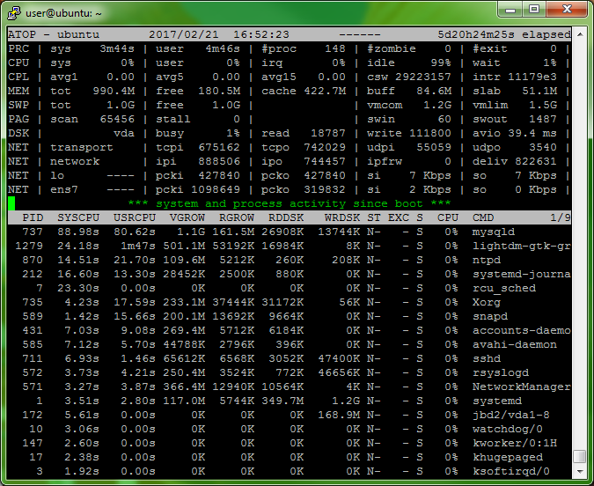
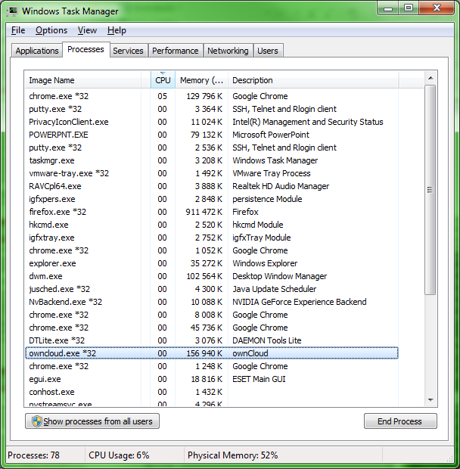
Task managers

Slide 12
Data structures of the tasks
Activities performed by programs
  Tasks have state and life-cycle
  Tasks have own and administrative data structures
Program data (in the task’s memory range)
  Code
  Static allocated data
  Stack: temporary storage, e.g. for function calls
  Heap: runtime (dynamic) allocated memory space
Administrative data (managed by the kernel)
  Task (process, thread) descriptor
  Unique ID (PID, TID)
  State
  Context of the task: the descriptor of the execution state
    Program counter, CPU registers
    Scheduling information
    Memory management state
  Owner and permissions
  I/O state information
Stack
Free memory
Heap
Static data
Code
PID
State
Context
Permissions
I/O state
…

Slide 13
Where to store the administrative data?
In the kernel’s memory range?
  „Expensive” area, the kernel’s memory usage should be minimized
In the memory range of the process?
  More difficult to be accessed by the kernel
How often this data is accessed?
  Often -> should be stored in the kernel’s space
  Rare -> should be stored in the process’ space
Classification of administrative data
  Mostly needed when the process is running
    Permissions
    State and data of system calls
    I/O operation data
    Accounting and statistical data
  Mostly needed for handling processes
    ID-s
    Running and scheduling states
    Memory management data
UNIX example
u-space
process-space
proc structure
kernel-space

Slide 14
The states of the tasks
Creation
  The task’s program loaded
  The kernel creates the data structures and register the new task
  The task enters into the ready-to-run state
Operation
  ready-to-run (waiting for the CPU)
  run (the task’s program is running on the CPU)
  waiting (waiting for a certain event)
Termination
  The program terminates itself, or the OS detects a fatal error and terminates the task
ready-to-run
running
Creation
waiting
Termination

Slide 15
State transitions of the tasks
State transitions are caused by system calls and interrupts
  The system call also results an interrupt
  Therefore the state transitions are caused by interrupts
  Therefore the kernels are interrupt (event) driven
Changing into kernel mode can occurred when the task is in running state
  The running state can be subdivided (user and kernel mode)
The transition run –> ready-to-run is performed by the kernel’s scheduler (details later)
running
(user mode)
system call
interrupt
scheduler
ready-to-run
running
(kernel mode)
Task creation
event occured
Creation
waiting
Termination

Slide 16
How tasks are created?
The first few tasks are created by the kernel when the system boots
The init or Wininit starts the services of the OS
  Before the user login, already ~100 tasks are running
User logs in, and starts programs
Simple example in UNIX:
  if ((res = fork()) == 0) { // child’s branch
    exec(...); // for example: another program is loaded
    // if returns: exec error
  } else if ( res < 0 ) { // parent’s branch, checking errors
    // for example: if there is any errors during fork()
  }
  // res = CHILD_PID (>0), the parent’s code runs forth
  The fork() method duplicates the current process (starting a new process)
    All process data is „copied”
  The exec() method loads the new programs code into the initiator programs memory space

Slide 17
Tree of UNIX processes
A process can only created by another process
  Every process has a parent and may have children
  In this way the processes can be ordered in a tree
  The parent can change (if the parent process terminates)
The fork() method returns the children’s PID to the parent
  The parent can manage its children
The root process (PID=1, e.g.: init)
  Parent of every process
  Runs till the system runs
  Inherits the „orphan” processes
  Manages/controls some of the system services
Family is important
  The parent gets notification if the child process is terminated

Slide 18
Switching tasks on the CPU
The running task gives up the right of running (voluntarily)
  Terminates itself (exit())
  Performs a system call and waits for its result
The right of running is taken away from the running process
  E.g.: time division systems, the process time slice is over
  The scheduler can take away the right of running in certain systems
  Due to interrupt or exception (error handling)
Preemptive and non-preemptive schedulers
  The preemptive scheduler can take away the right of running from the processes
  When using non-preemptive scheduler only the process can give up the right of running
  The right of running can be taken away in both cases when interrupt or exception (error) occurs

Slide 19
State transitions with preemptive scheduler
running
(user mode)
Preemptive
scheduler
ready-to-run
running
(kernel mode)
Creation
waiting
Termination

Slide 20
The context change
Context (the descriptor of the execution’s state)
  Program counter (PC), CPU, MMU states, etc.
  The kernel has its own context, on the level of the kernels own tasks
If two tasks switching between the CPU, the context has to changed
  The context of the running task has to be saved
  The execution state of the former running task has to be restored
  The control is passed to the now running task
The interrupts causes context changes (task -> kernel)
  A small part of the actual context is saved by HW instructions
  (The interrupt handler performs additional state saving)
  The interrupt handler runs and returns to point before the IT
  During the return, the former context is restored
System calls are works with interrupts -> causing context changes
  Switching between user and kernel mode is also a context change
There are many context changes during the operation of the OS
  Context changes should be implemented with minimal overhead
  In some cases saving the whole context isn’t necessary -> IT handler don’t change the whole context, only a small part of it (PC, CPU registers…)

Slide 21
Execution mode and context
User mode
Kernel mode
The task’s program is running
The task is performing a system call
Task context
Kernel context
(empty)
IT handling and system management

Slide 22
Summary
High number of tasks with different nature (simultaneously)
  I/O intensive (less computation, lot of waiting)
  CPU intensive (more computation, less waiting)
  Tasks requiring real-time operation (deadline)
  Multimedia tasks
  (There are some system task along user tasks)
  The user expectations can be various
    Waiting time, response time, turnaround time, throughput, resource utilization
The basics of task management
  Task: a program during execution, it has a state and life-cycle
  Abstract virtual machine: „virtual” CPU and memory for the tasks
  Process: a task with its individual memory range, may contain threads
  Thread: A task with sequential operation, it may share memory with other threads
The life-cycle of tasks
  Creation, ready-to-run, run, waiting, termination
  The context changes are caused by interrupts
  The task change means context change, which is often during the kernel’s (and the OS) operation

